Slide 1
Project management GUIDE

Slide 2
Presentation summary
Azure devops
Weekly meetings

Slide 3
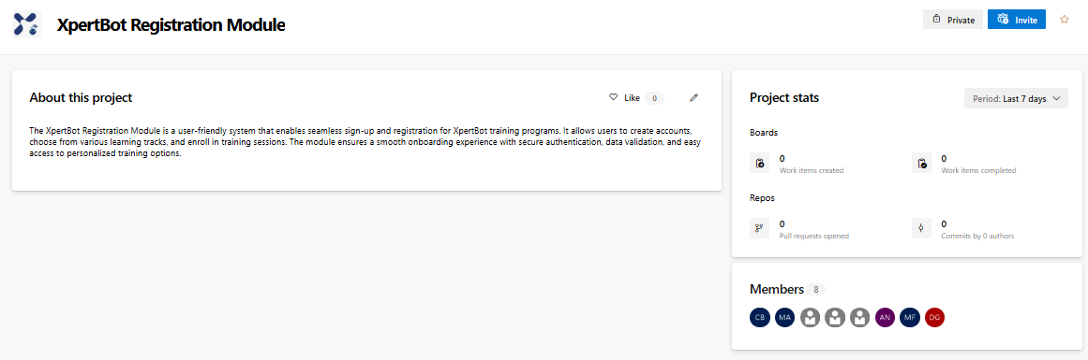
Azure devops
Created a project and invited every member to join
Image 1: Azure Devops Project Creation

Slide 4
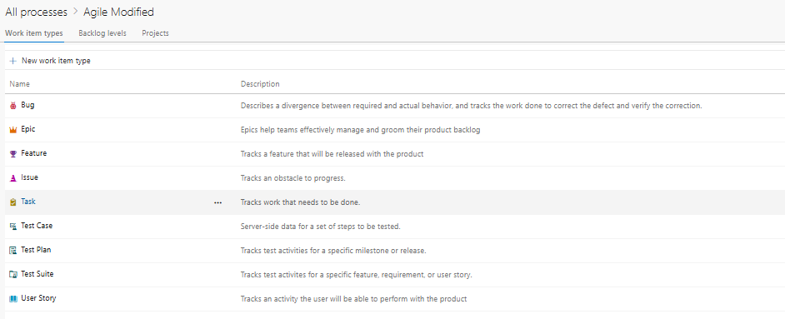
Azure devops
Created the agile modified process and chose it for the project
Image 2: Azure Devops Project Creation

Slide 5
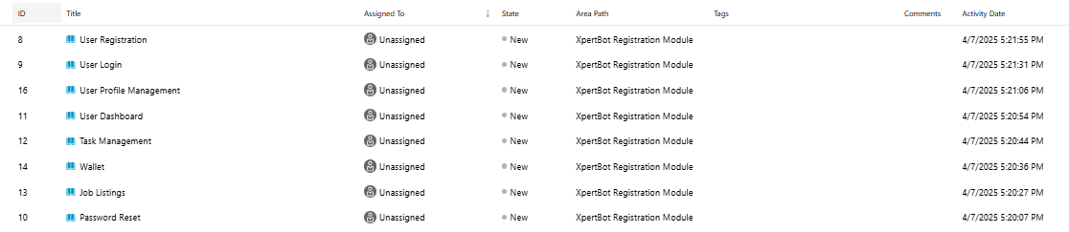
Azure devops
Created the user stories
Image 3: User Story Creation

Slide 6
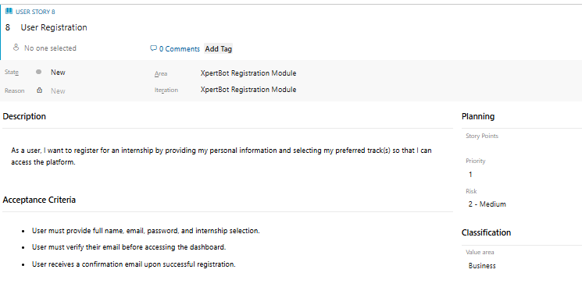
Azure devops
Set the Description & Acceptance Criteria for every User Story
Image 4: User Story Sample

Slide 7
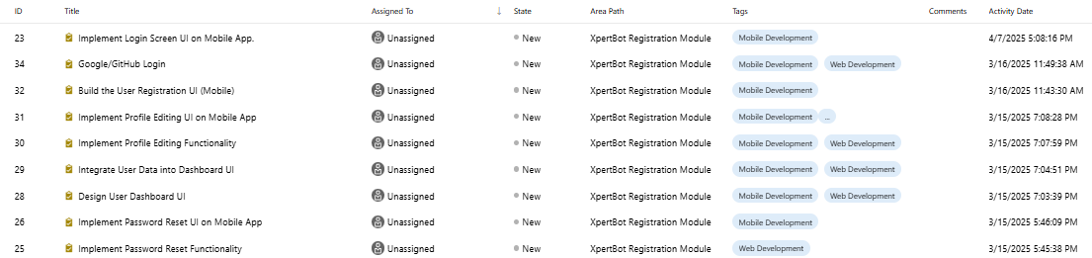
Azure devops
Created the tasks for every user story while also adding tags to facilitate the filtering process
Image 5: Task Creation

Slide 8
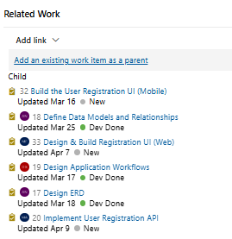
Azure devops
Linked the user stories to each task
Image 6: Linking Tasks to their Respective User Story
(Parent-Child Relationship)

Slide 9
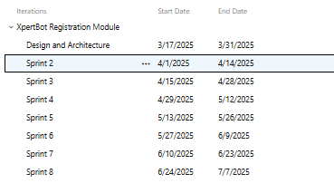
Azure devops
Created the sprints/iterations
Image 7: Sprints Creation

Slide 10
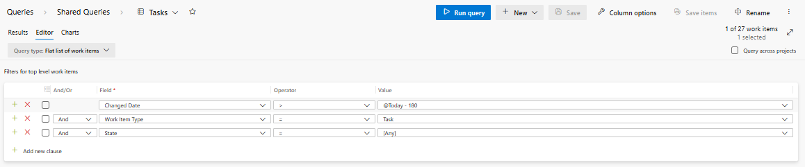
Azure devops
Created shared queries to be used in the dashboard later on
Image 8: Shared Queries Creation

Slide 11
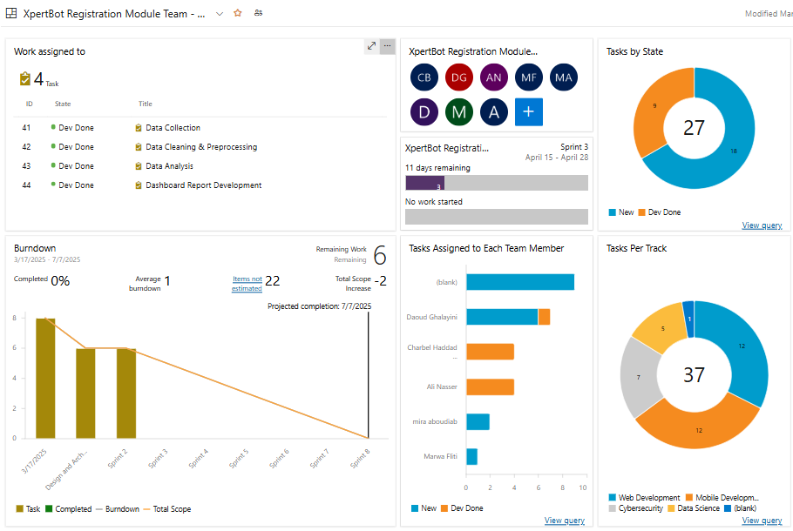
Azure devops
Created dashboard to reflect team, sprint and personal progress and growth
Image 9: Dashboard reflecting Team & Personal Progress

Slide 12

Weekly meetings
Created a whats app group and link for the weekly meeting
Image 10: Virtual weekly meeting

